Slide 1
Solving the Digital Divide
Technology Adoption Strategies
Anthony Owen - State Director - Computer Science Education
Don Benton - Assistant Commissioner - Research and Technology

Slide 2
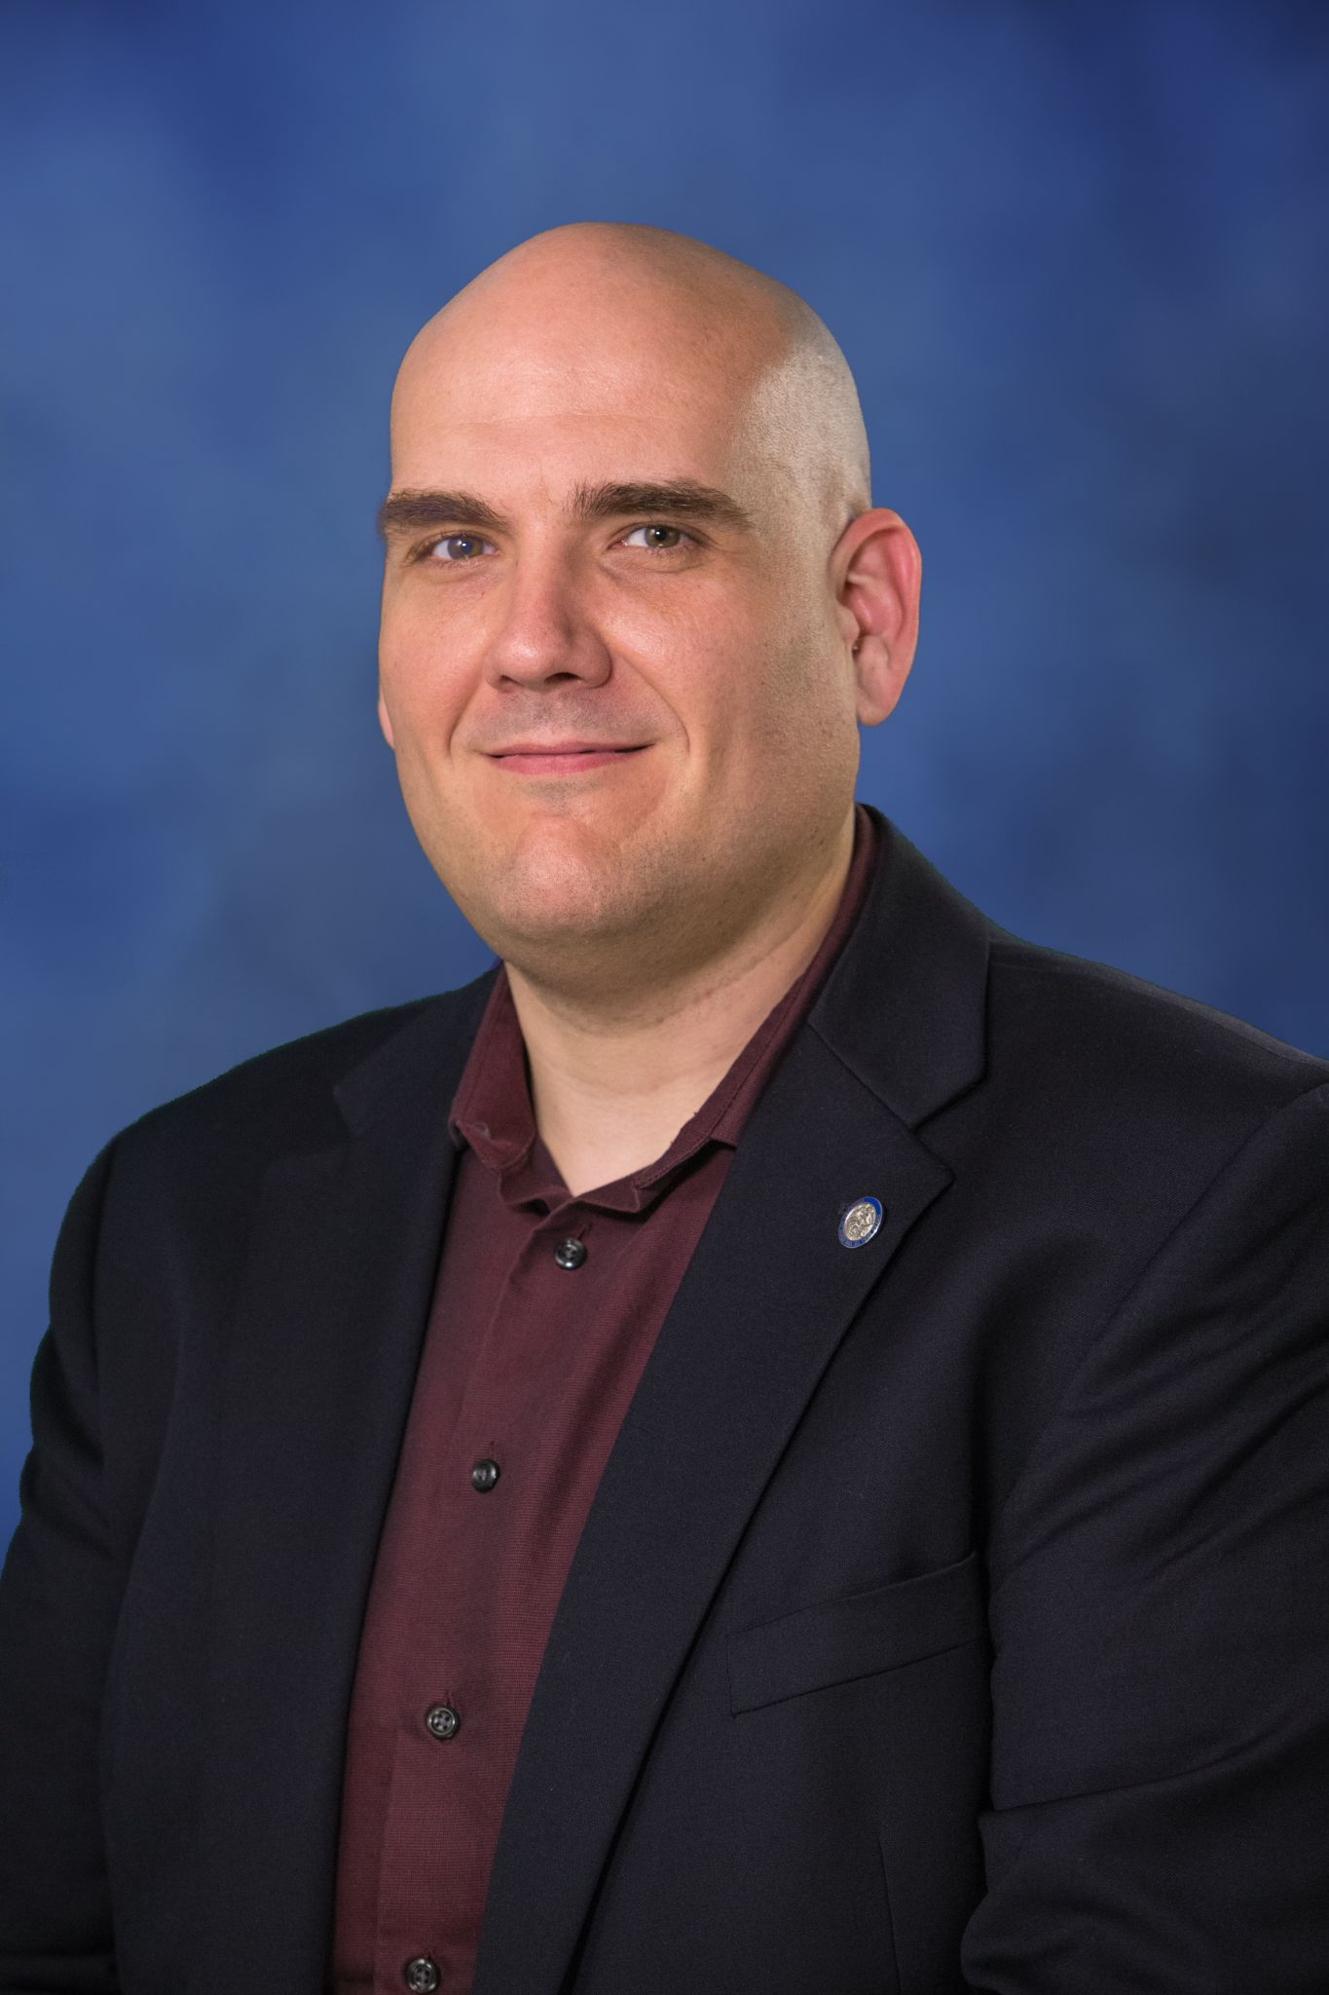
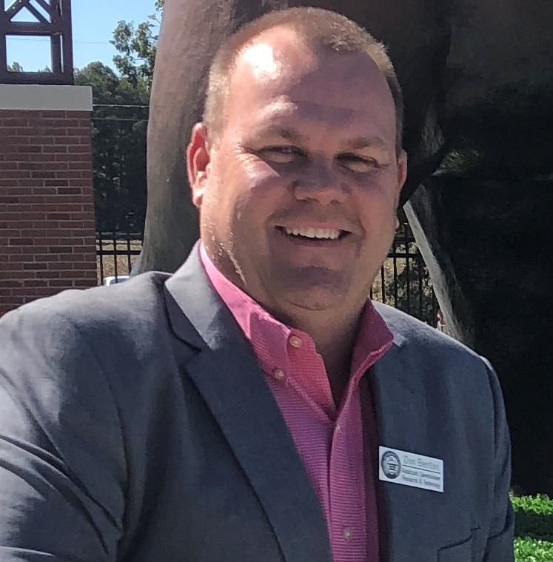
Technology Adoption Strategies
Anthony Owen
Don Benton
AR State Director of Computer Science Education
anthony.owen@ade.arkansas.gov
Asst Commissioner AR DOE, Research and Technology Division
don.benton@ade.arkansas.gov

Slide 3
Utilizing Social Media to Solve a Challenge
Arkansas announced school closure for F2F instruction on March 15, 2020
Schools Without Walls Team ramped up Facebook presence the same day as an attempt to gather some free resources as a small group
AMI for Arkansas Teachers (Alternative Methods of Instruction)
About 24,000 members sharing resources
10 different countries - 91% female contributors
Thousands of free tools and resources
Administrator oversight to avoid various hot topics and debate
Currently shifted back to Schools Without Walls

Slide 4
Connecting Kids - Arkansas Hotspot Project
$10,000,000 GEER funds from Governor Asa Hutchinson
20,000+ hotspots for kids
Unlimited usage
2 years
FREE to schools
CIPA compliant
Additional hotspots available to schools under state contract pricing
T-Mobile, AT&T, Verizon
Device included
Tech support and logistics provided by partners in collaboration with school technology point of contact

Slide 5
Creating Resources
Developing a resource document on digital access solutions.
The Arkansas approach to learning plans.
Building requirements into assessments.
Crafting vendor agnostic standards.

Slide 6
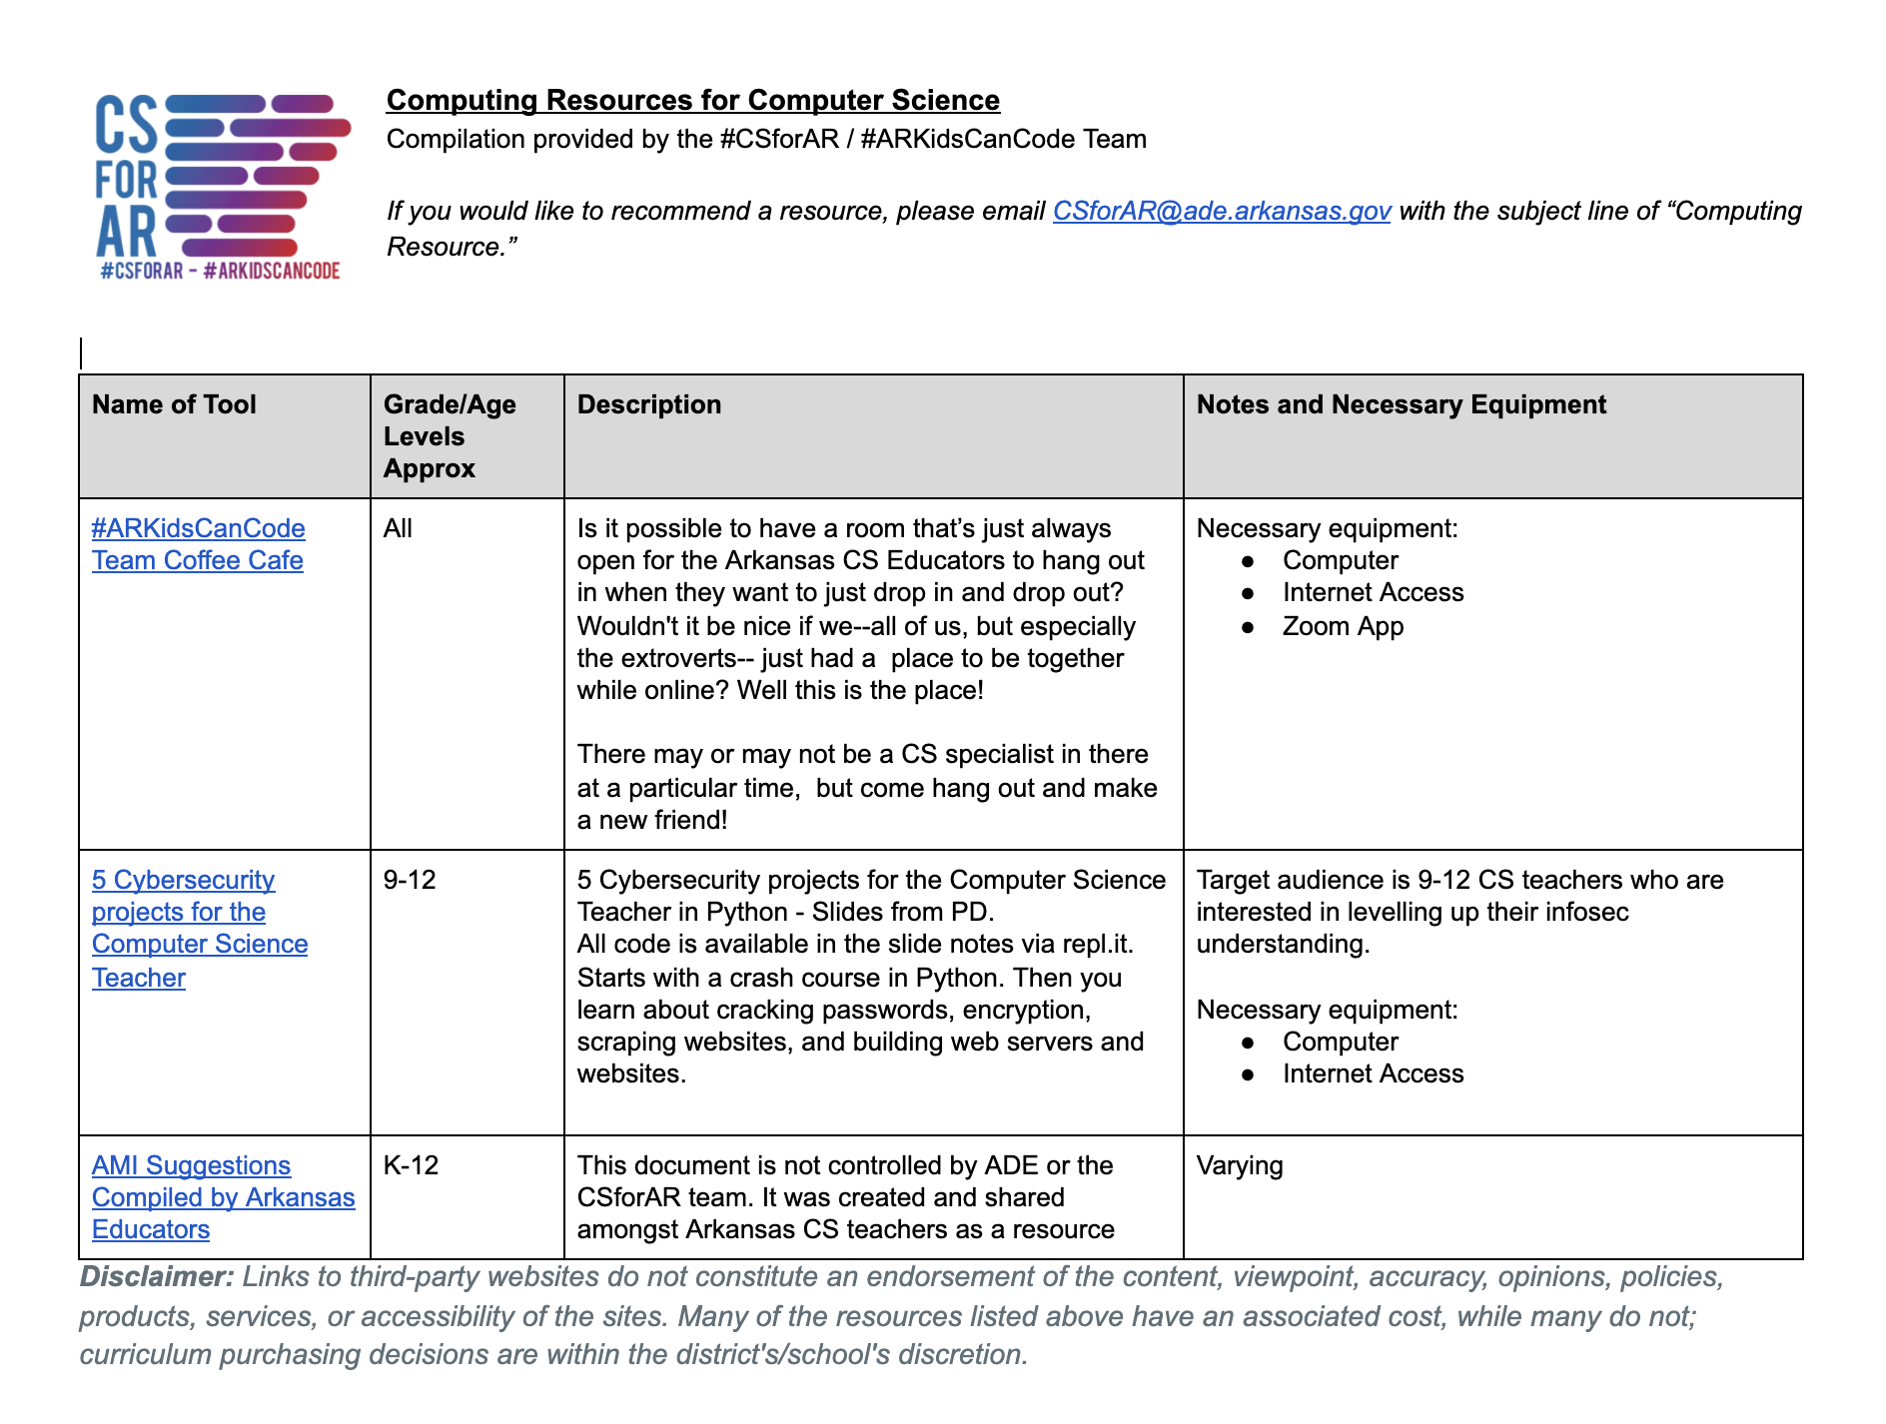
Rethinking the Normal
Computer Science and Computing Unit Created an AMI Resource Document (http://bit.ly/ARCSAMI)
Housed resources for teaching computer science content at all levels remotely
Early on was also regularly updated with information about consumer COVID pandemic support programs that companies were launching or had available
http://cs.arkansas.gov | CSforAR@ade.arkansas.gov

Slide 7
Rethinking the Normal
Computer Science Coffee Cafe (https://bit.ly/ARCSCoffee)
Zoom based, which our team had been using regularly since 2016
The Coffee Cafe Launched on March 19, 2020
Open every weekday from 8:00a.m. – 4:00p.m. since its launch
Has turned into a “digital office” for our team
Every team member has their own office and we have four “do not disturb rooms”
1 Year Statistics (05/25/2020 - 05/25/2021)
287 Sessions
Average of 434 minutes per session; over 2074 hours of it open and “manned” by members of the CSforAR team
Over 6,370 participants logged into the cafe; an average of 22 per session

Slide 8
Planning Ahead for Technology Amid a Pandemic
Pandemic purchasing isn’t like anything we have ever experienced
Plan for delays and issues
Purchasing and procurement delays
Price fluctuation
Service delays
Transitioning to different products and tools
Tech support staff
Training and support
Unavailable products or use what you have (repurpose old devices)
Spending ESSER 1, 2, and ARP
ECF (Emergency Connectivity Fund) and EBB (Emergency Broadband Benefit)
Establish partnerships with trusted vendors
Arkansas Ready for Learning Resource Guide

